Slide 1
Phonemic Awareness

Slide 2
Let’s Practice Identifying Beginning Sounds
Say the beginning sound for each picture you see!

Slide 3
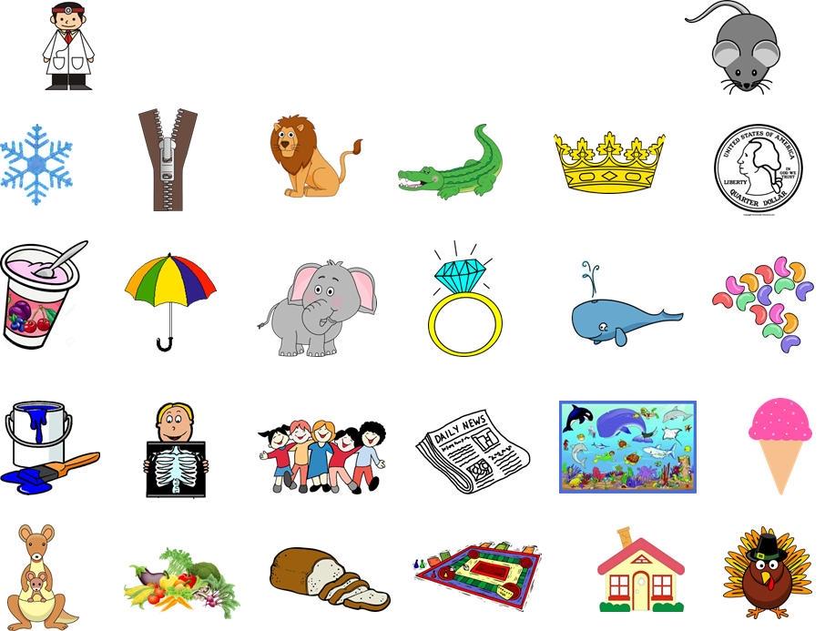

Slide 4
Let’s Practice Identifying Ending Sounds
Say the ending sound for each picture you see!

Slide 6
Let’s Practice Identifying Middle Sounds
Say the middle sound for each picture you see!

Slide 8
Let’s Practice Identifying Rhyming Words
Can you find some rhyming picture pairs? Can you think of your own rhymes too?

Slide 9
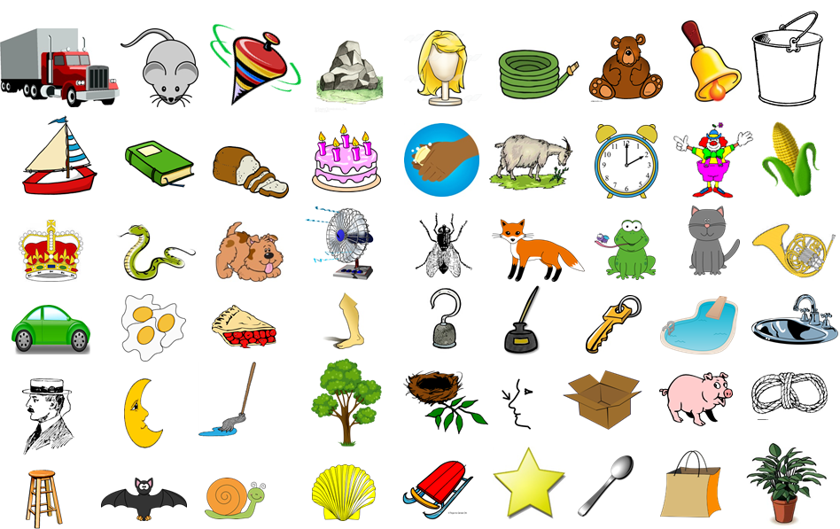

Slide 10
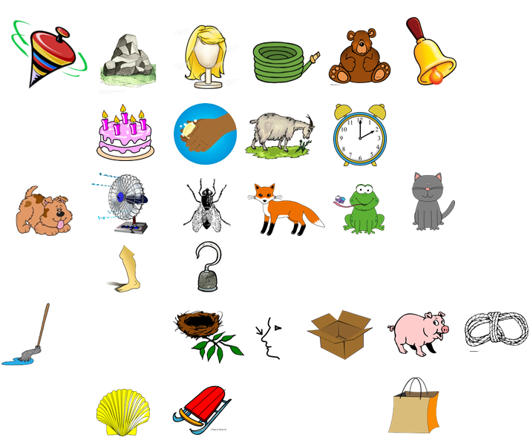
Segmenting - Let’s stretch these words down our arms!

